Slide 1
Setting UP TAK Server Virtual Machine

Slide 2
Download/Setup our VM
Go to the following link: https://www.virtualbox.org/wiki/Downloads
Under “VirtualBox 7.0.20 platform packages” select your operating system host (Windows hosts)
Once it is done downloading open the file and following the set-up instructions

Slide 3
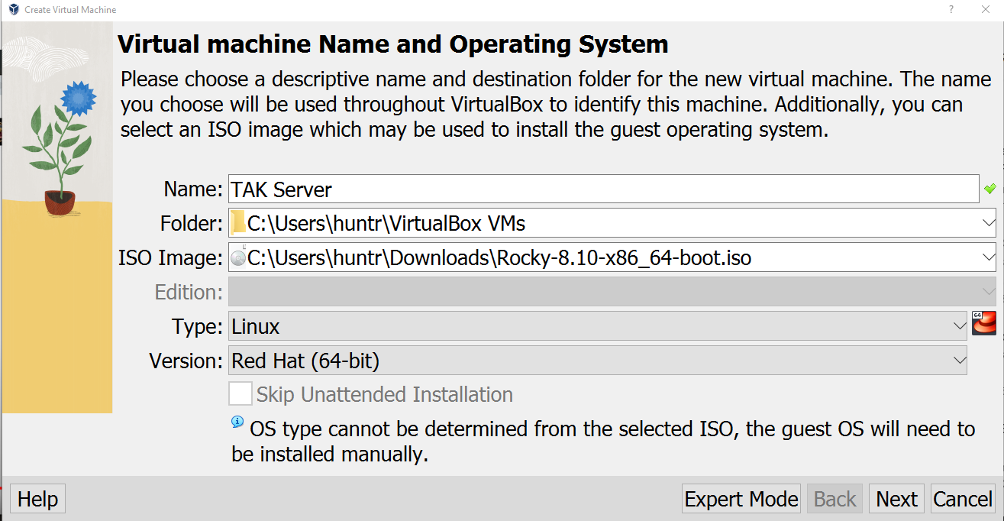
Create Our TAK Server VM
With the VM open select “New”
Fill in the following fields:
Name: “Name your TAK Server” (TAK Server)
ISO Image: Rocky-8.10-x86_64-boot.iso
You should be able to select the drop down and see the Rocky-8 boot iso.
Type: Linux
Version: Red Hat (64-bit)
Select Next

Slide 4
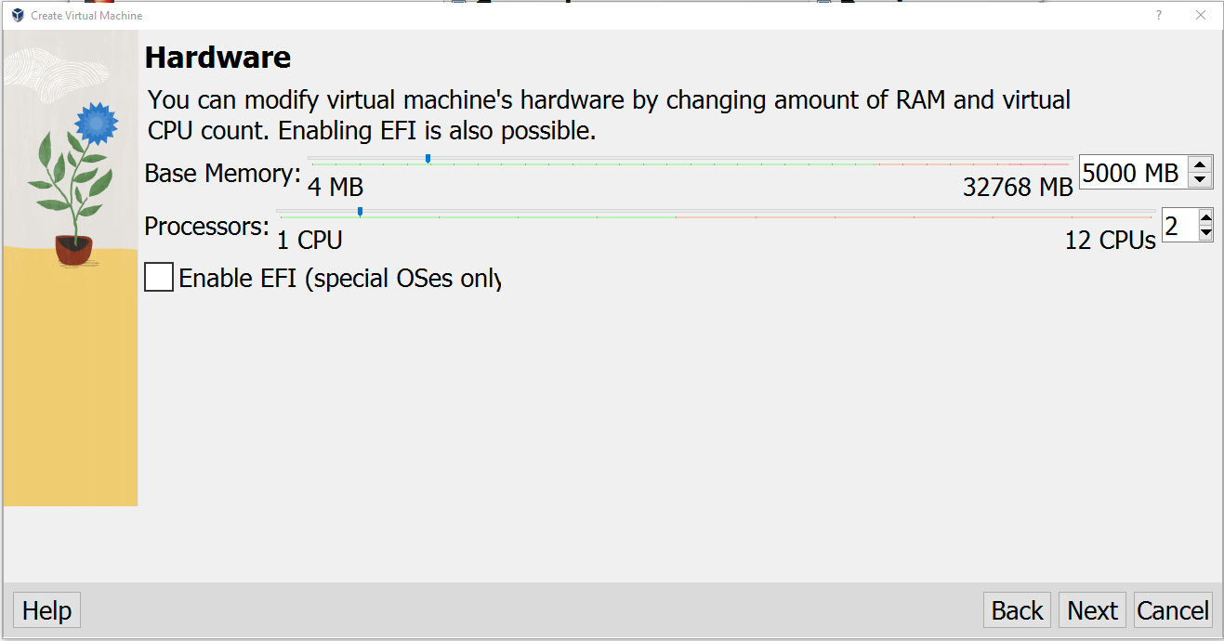
Creating Our TAK Server VM – Hardware
Base Memory: 5000 MB
We want to have around 5 Gb of memory, but it all depends on your machine.
You can always add more.
Processors: 1 CPUs
Similarly to the memory this all depends on your machine, you can always add more.
Select “Next”

Slide 5
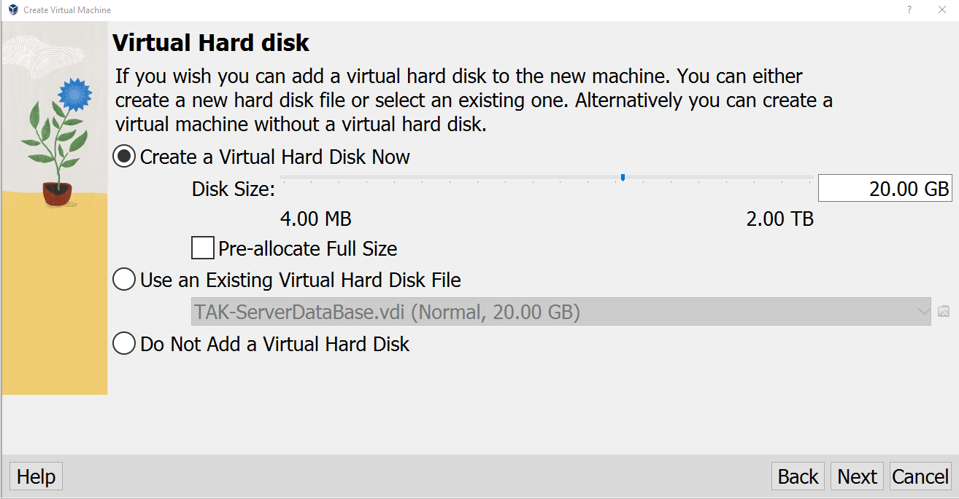
Creating Our TAK Server VM – Virtual Hard Disk
Select “Create a Virtual Hard Disk Now” if it’s not already.
Set the “Disk Size:” to a minimum of 15 GB
Again, this can be increased to whatever desired size, depending on your machine's specs.
Select “Next”

Slide 6
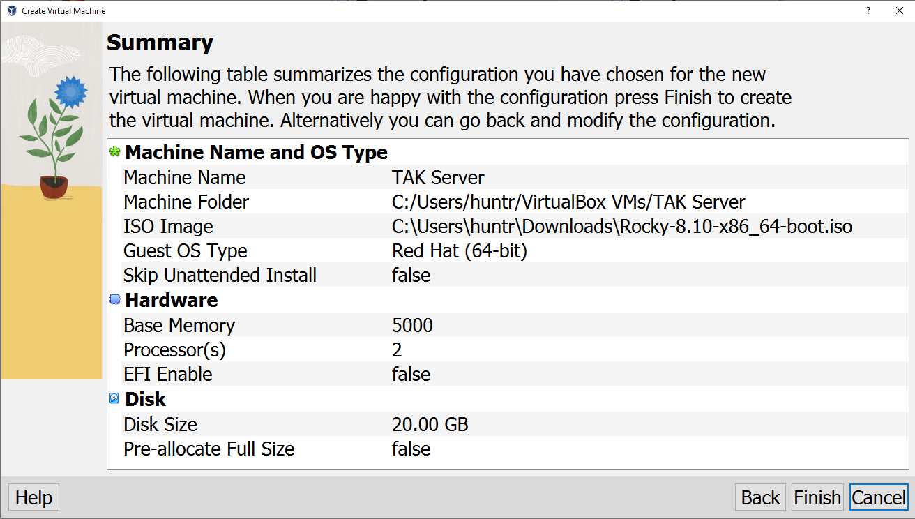
Creating Our TAK Server VM – Summary
You should now see the summary page where you can validate the specs of your VM
Once done select “Finish”

Slide 7
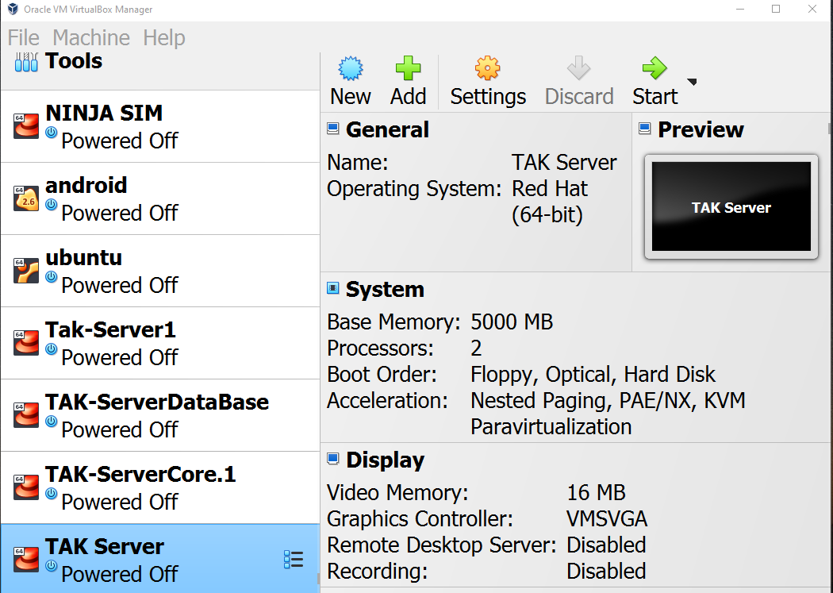
Creating a Bridge Network
Navigate to the VM Virtual Box.
With your TAK Server highlighted select “Settings”
From the settings do the following:
Select Network
Select Adapter 2
Enable: Enable Network Adapter
Set Attached to: Bridge Adapter
Select Advanced
Set Promiscuous Mode: Allow All
Select “OK”

Slide 8
Starting Our TAK Server VM
You should now see your TAK Server VM on the left panel.
Start up your VM
Double click your server to start it or select the server then select start at the top right

Slide 9
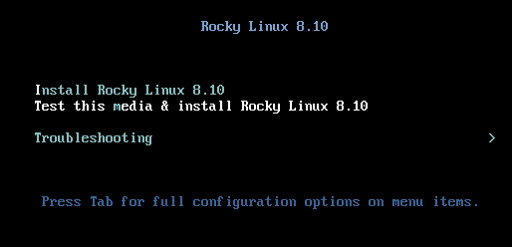
Configuring Our TAK-Server
You should now see the Rocky Linux 8.10 install window.
Hit Enter
Let the VM initialize.
Note: To use your mouse cursor outside of your VM select your right “ctrl” key

Slide 10
Configure Rocky Linux
Once at the “Welcome to Rocky Linux 8.10” screen walk through the setup guide.
Language: Choose your preferred language
Continue

Slide 11
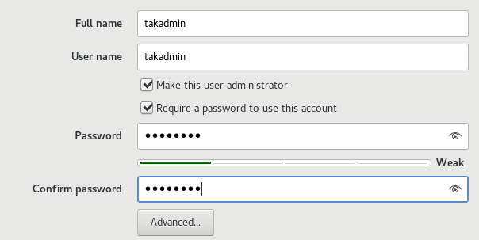
Rocky Linux Installation Summary – User Settings
Once at the “Installation Summary” page complete the “User Settings”
Select “Root Password”
Provide a root password, something that overly complicated.
If the password is simple, it is ok you will need to select the “Done” button twice.
Root Password: atakatak
Confirm the password by typing it again.
Select “Done” at the top right.
Select “Create User”
Full name: provide a name (takadmin)
Username: (this will automatically be the same as the Full name if you wish to change it you may, but not necessary)
IMPORTANT: Make sure the “Make this user administrator” box is enabled
Password: provide a password and confirm it, for simplicity I will use the same one as the root admin (atakatak)
Select “Done

Slide 12
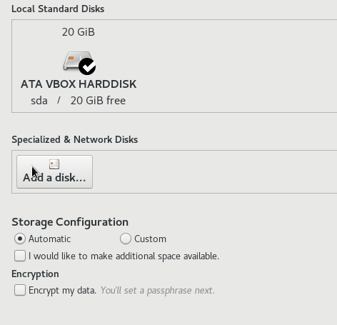
Rocky Linux Installation Summary – System
Select “Network & Host Name” under the “SYSTEM” section.
For Ethernet (enp0s8), toggle the switch on the right side of the screen from “off” to “on”.
The switch for Ethernet (enp0s3) should be off.
Select “Done”
Select “Installation Destination” under the “SYSTEM” section.
Confirm that the Local Standard Disks has a check mark over the drive.
Confirm that the Storage Configuration section is set to Automatic
Select “Done”

Slide 13
Rocky Linux Installation Summary – Software
Select “Software Selection” under the “SOFTWARE” section.
In the “Base Environment” section select the “Server with GUI” option.
Select “Done”

Slide 14
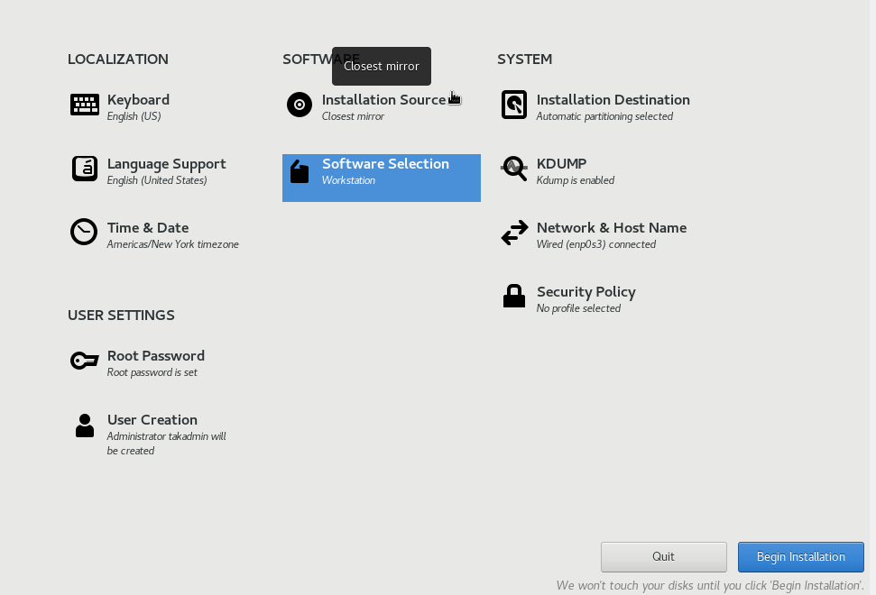
Rocky Linux Installation Summary – Begin Installation
The “Installation Summary” page should look as follows:
If it does, then select: “Begin Installation”
Note: This will take a while.
Once the installation is complete the “Reboot System” will now be blue and you can select it.
Notes:
# If you run into issues with the installation source where it wont automatically load: try restarting the download process but enable the bridged connection first. Then in the network section enable the bridge options only? at least that was the one I only enabled.

Slide 15
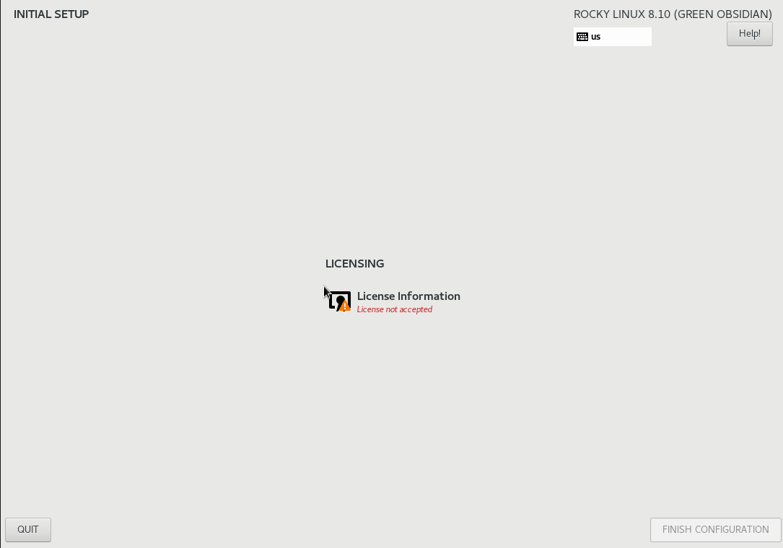
Rocky Linux Setup
Once you hit reboot let it load full to the following screen:
From here select the “License Information” tab.
At the bottom of that screen select the “I accept…” statement.
Select “Done”
When back at the Initial Setup screen select “Finish Configuration”

Slide 16
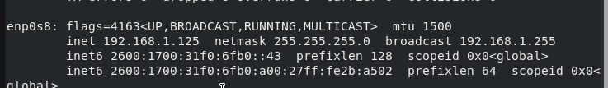
Configuring Network Settings
Select your user and login.
Finish setting up.
Open the terminal and type the following:
ifconfig
This will display the current network interface configuration information.
If you do not see a valid network IP address, you will need to shut down your VM and set up the Bridge network again.

Slide 17
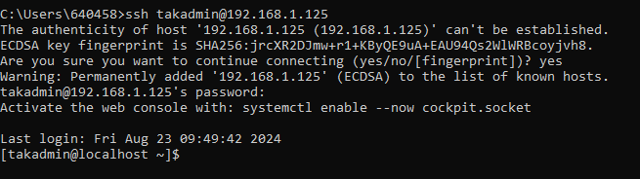
SSH(Secure Shell) into our TAK Server – Terminal
Terminal
You can ssh into your server from the terminal command line by opening your preferred terminal and typing the following:
ssh <username>@<ip address>
This will ask you to verify you want to connect, type “yes” and press enter.
You will then be asked for the password for the user.
Note: the text will be invisible so you will not be able to see what you are typing.
Once you enter the password hit enter and you will be connected.
When you successfully ssh into the server the command line will look like the following:

Slide 18
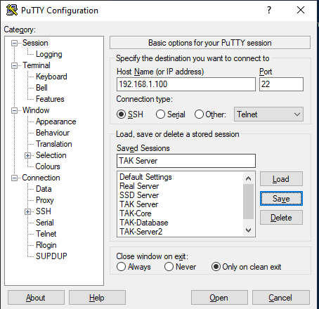
SSH(Secure Shell) into our TAK Server – PuTTY
PuTTY
PuTTy is a tool that can be leveraged on windows to connect to other clients instead of using the terminal to ssh.
It can be downloaded at the following link:
https://www.putty.org/
Once open you will enter the following:
Host Name (or IP address): <IP address>
Connection Type: SSH
Saved Sessions: <Server Name>
Select “Save” and the session will be saved for ease of access later.
When connecting again later you simply have to select the session you want to connect to then “Load”.
Now select “Open”

Slide 19
SSH(Secure Shell) into our TAK Server – PuTTY
You will be prompted with a “PuTTY Security Alert”
Select “Accept”
You now can login to the client
Login as: <username>
<username>@<IP address>’s password: <enter your password >
The password text will be invisible so you will not be able to see what you are typing.
Once done enter your password hit Enter.
You should be connected to the server.

Slide 20
Setup TAK Server

